Slide 1
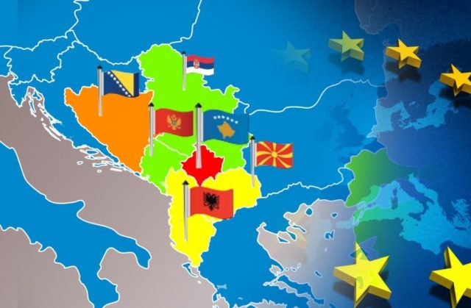
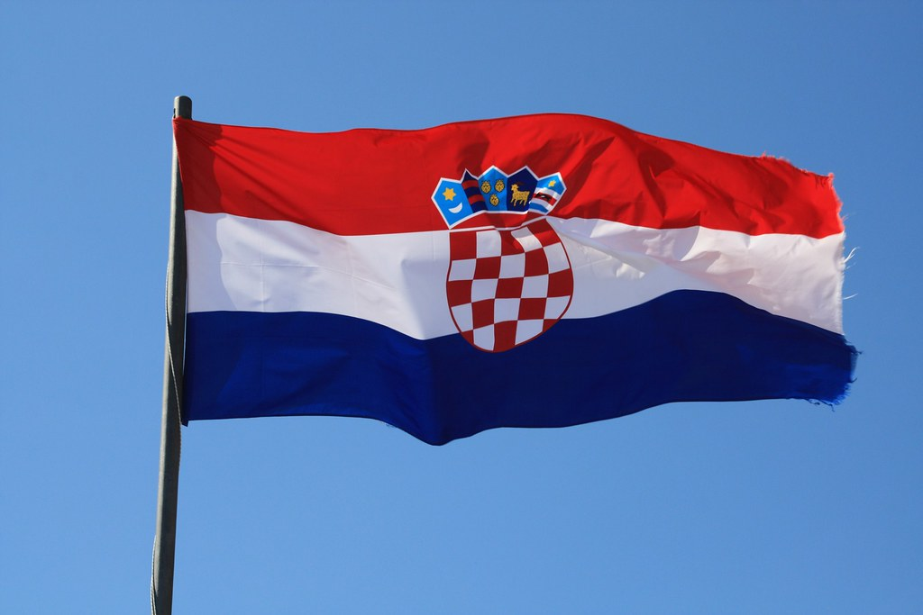
Energy Security in the Western Balkans
Dr. Sebastian von Munchow
George C. Marshall Center for Security Studies

Slide 2
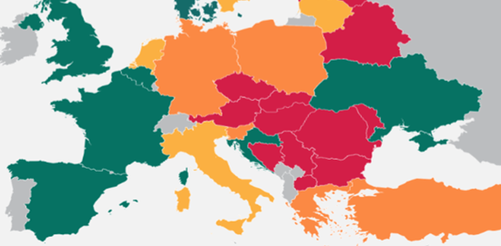
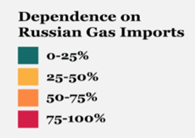
Western Balkan’s Energy Landscape
Dependency on Russia’s energy | Serbia, Bosnia & Herzegovina, North Macedonia: 100% reliant on Russian gas Implications: Severe energy shortages if supplies stop Transition: EU's role crucial in addressing this issue
EU Support for Western Balkans | Western Balkan Summit, Nov 2022: €1 billion package for energy resilience & diversification New EU Energy Support Package: Total of €2.5 billion in investments Immediate, short, and medium-term measures Short and long term period: €500 million short term: Households & SMEs €500 million long term: Diversification, renewables, interconnections
REPowerEU Project | Aims to cut EU's dependency on Russian energy (impact in WB) €300 billion plan By two-thirds by end of 2022 Zero dependency by end of 2030

Slide 3
Energy Pipelines
Turkish Stream Pipeline
Trans-Anatolian Natural Gas Pipeline (TANAP)
Trans-Adriatic Pipeline (TAP)
Ionian-Adriatic Pipeline (IAP)
Southern Gas Corridor (SGC)
Connects Russia to Turkey and Europe.
Key transit countries: Serbia and Macedonia.
Starts in Azerbaijan, through Turkey.
Passes through Bulgaria, Serbia, Hungary.
Connects Azerbaijani gas from TANAP through Greece, Albania to Italy.
Reduces Western Europe's dependence on Russian gas.
Connects Albania, Montenegro, Croatia to the Southern Gas Corridor
Transports gas from the Caspian and Middle East to Europe.
Main source: Shah Deniz II field in the Caspian Sea.
Includes pipelines: SCP, TAP, TANAP.

Slide 4
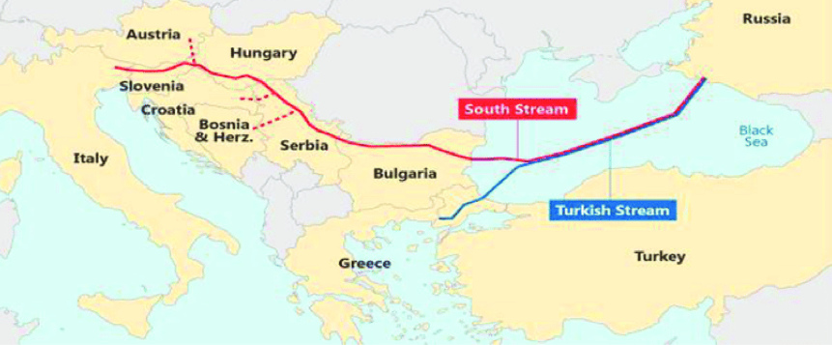
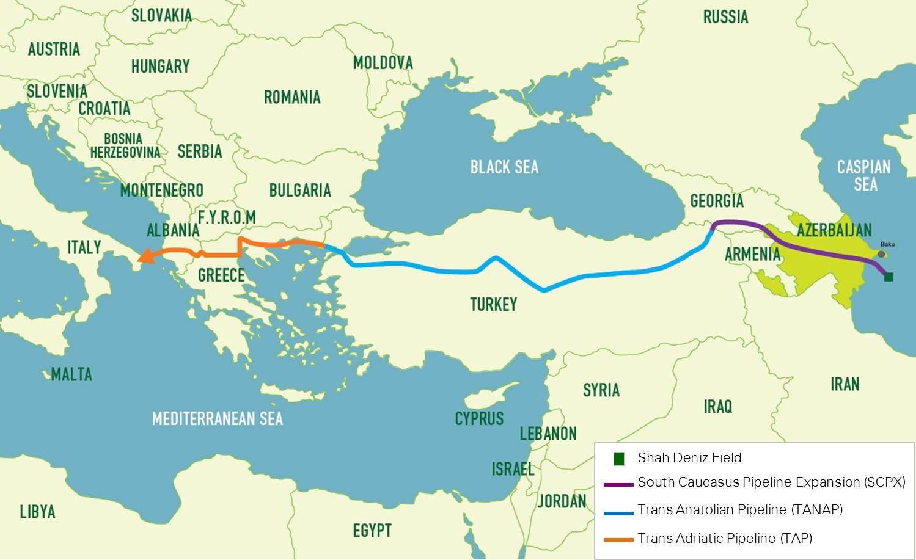
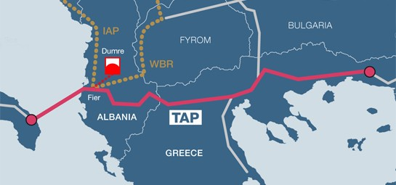
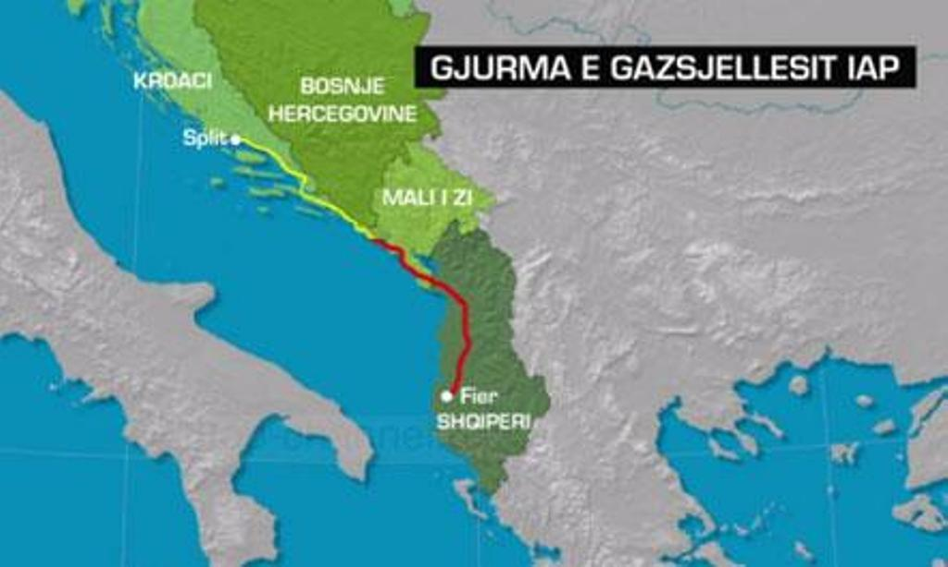
The Trans-Adriatic Pipeline
Ionian-Adriatic Pipeline (IAP)

Slide 5
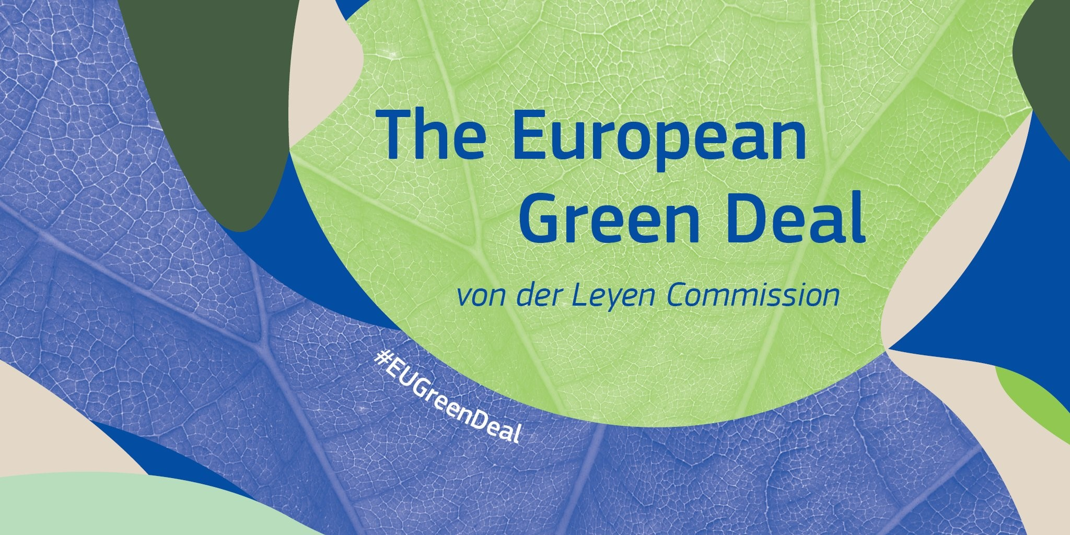
Implications for the Western Balkans:
Challenges: Investment in new infrastructure, potential short-term energy price hikes.
Opportunities:
Greater energy security & diversification.
Economic growth and job creation in renewable energy and energy efficiency sectors.
EU Support:
Financial and technical aid via the Just Transition Fund and InvestEU.
Aims: Shift to low-carbon economy, enhance energy security, and EU energy market integration.
Goal: Achieve climate neutrality in Europe by 2050.
Since 2021, €730 million committed to support.
5 Pillar Areas:
Decarbonisation and climate resilience
Circular economy
Depollution (air, water & soil)
Sustainable food systems & rural areas
Biodiversity protection & restoration
Notes:
Context:
Western Balkans face rising energy costs due to factors like high electricity imports, technical issues, and high energy intensity.
Outdated power plants and biomass usage result in pollution.
Energy crisis affects both industrial and household prices, leading to increased costs for goods and services.

Slide 6
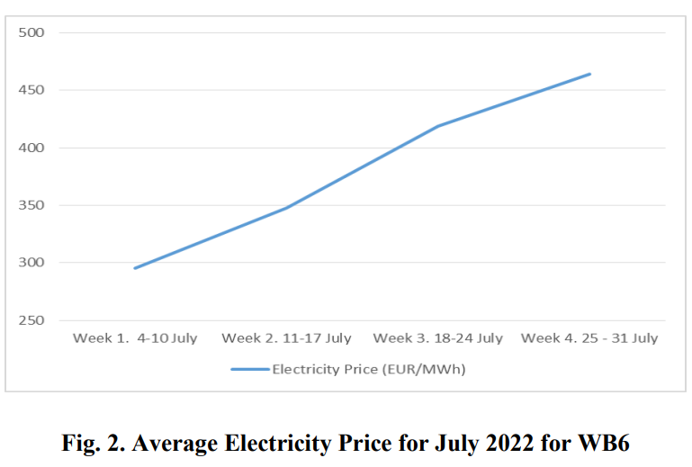
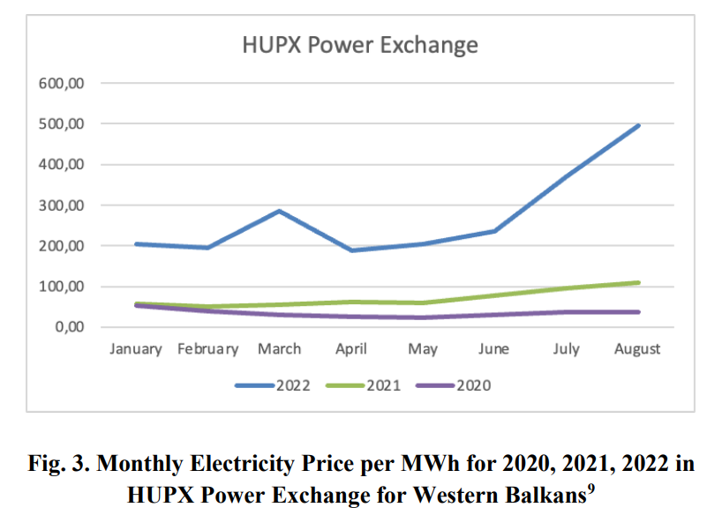
Utility Bill Payments:
Lowest income households behind on utility bills:
Kosovo & North Macedonia: 68%
Montenegro: 65%
Serbia: 48%
Albania: 43%
Highest income households:
49%, 34%, 17%, 8%, 27% respectively (Source: BGF)
Household Expenditures:
WB6 average family spends 7-10% of budget on energy (Source: World Bank Study on Energy Crisis, 2022).
Energy costs disproportionately burden low-income households and women.
Notes:
Source: Balkan Green Foundation (BGF)
Utility Bill Payments: This section highlights the challenges faced by households in different income brackets regarding their utility bills:
The lowest income households in several countries are struggling significantly more than their wealthier counterparts. For example, 68% of the poorest in Kosovo and North Macedonia are behind on their bills.
In contrast, the percentages of the highest-income households behind on bills are consistently lower across all countries.
Ongoing Crisis: This point underscores the exacerbating impact of the current energy crisis. It emphasizes the disproportionate effect on those already facing energy poverty and calls for the governments of these countries to take responsive measures.
Household Expenditures: The data here is from a World Bank study conducted in 2022. It reveals that on average, families in the WB6 region spend between 7-10% of their entire budget on energy alone. This high expenditure is especially burdensome for low-income households and women.

Slide 7
The Way Forward for Energy Security in the Western Balkans
Alignment with the EU - Pivot to the EU for energy security and policy adherence. - Embrace the EU's green agenda regulations and policies. - Collaborate with the EU to develop country-specific green transition strategies.
Diversification & Cooperation - Diversify energy production and supply chains. - Enhance regional cooperation within the Berlin process framework. - Prepare joint renewable energy investment proposals. - Integrate electricity and gas markets.
Immediate Energy Challenges - Short-term reliance on coal due to energy crisis pressures. - Plan for phased-out coal-fired power plants in the coming years.

Slide 8
Thank you!

