Slide 1
Volunteers/Mercenaries in the Ukrainian Theatre: Serbian case study
Vanja Rokvić

Slide 2
History of mercenaries/ Volunteers
A new phenomenon?
e.g. Spanish Civil War, 1936–1939
Rise of PMC during the 90’s

Slide 3
Serbian mercenaries/ Volunteers in the the Ukrainian Theatre (2014)
Serbia-Hussar Regiment, 1st Slavic Unit, Batman Unit, Rusich Unit, Ryazan Unit, Unité Continentale, 7th Brigade, Ural Unit...
300 Serbian citizens involved in the war in Ukraine on the side of the DNR/LNR
by the end of 2018, the Serbian courts identified 45 Serbian citizens who “have had legal proceedings started against them for allegedly going to fight on the battlefields of Ukraine”

Slide 4
https://balkaninsight.com/2018/12/13/donbass-brothers-how-serbian-fighters-were-deployed-in-ukraine-12-12-2018/

Slide 5
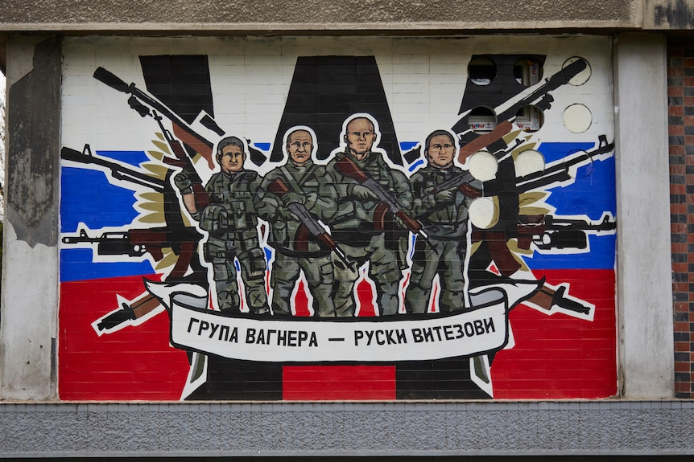
Serbian mercenaries/ Volunteers in the the Ukrainian Theatre (2022-): case of wagner

Slide 6
The Wagner Group advertisement for volunteers (RT Balkan): looking for volunteers between the ages of 22 and 50, who are not citizens of Ukraine, one of the countries of the EU or the NATO alliance, those who come forward are really interested in learning, that they are patriots and that they are strong in spirit, and everything else will be taught by the Wagnerians".
Number of Serbian citizens in Wagner?
Motivation to join Wagner or other private actors?

Slide 7
Security concerns
Human security
National security
International security

Slide 8
(IN)Effective respons for the phenomenoN?
Political
Judicial
Academic
Public

