Slide 1
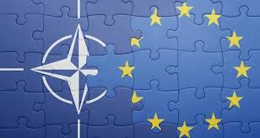
Marshall Center Alumni Security Forum
“NATO AND SECURITY COOPERATION IN THE WESTERN BALKANS - CHALLENGES AND LESSONS LEARNED”
THE FUTURE OF NATO – EU COOPERATION:
Re-Thinking Strategy Approach
Dr. Katerina VELJANOVSKA BLAZHEVSKA
Full Professor in Political Science,
Faculty of Security Sciences – MIT University
North Macedonia
Ohrid, 2023

Slide 2
After February 24, 2022..
The relations between NATO and the EU are clearly entering a new era
NATO is once again acting as a guarantor of the security and defence of the EU, playing a leading consolidating role
NATO has regained credibility and relevance in the eyes of elites and societies, is increasing its strength and moving towards expansion.

Slide 3
War in Ukraine - an accelerator of a set of processes (regionally and globally)
can potentially encourage a new culture of cooperation between the EU and NATO
Starting from consolidated positions, but also emphasizing new trends and practices.

Slide 4
The NATO 2022 Strategic Concept represents a step forward towards cooperative security
Comes at a critical time and the need to unite the alliance, to continue to guarantee international peace and security
Setting up a new concept initiates a process of transformation
Need of a New Grand Strategy, dedicated to the new global security challenges

Slide 5
Current overview..
Present “global world” transition to a new “regionalised world”, characterized by the regions’ of the world, “self-sufficient development”, and a permanent acute conflict between world’s several institutionalised regions

Slide 6
Towards a new security architecture?
Understanding how the NATO-EU relationship will evolve is not an easy step
Need of a reaffirmation of roles
Madrid Summit in June 2022, a new NATO Force Model was adopted
What do members expect from NATO?

Slide 7
Towards a new security architecture?
Democratic values and the rules-based order - STILL primary focus lies in areas directly related to its defence competence
The FOCUS allows the alliance to effectively address security challenges, deter potential adversaries, and ensure the collective defence of its member states

Slide 8
There is a need of..
NATO collaborations – besides civil-military cooperation, need for strategic long-term collaboration with public and private stakeholders, academia, individuals with aspirations
Ethical dimension of NATO should be emphasises in every action
Awareness of the socio-cultural dimension (diplomacy, military, economy, finance, intelligence, legal area) – Culture eats Strategy for breakfast

Slide 9
Providing different layers of communication -
The need to create a transparently informed public
Empowering the impact in the society – different target groups – micro strategy outside the governmental frame

Slide 10
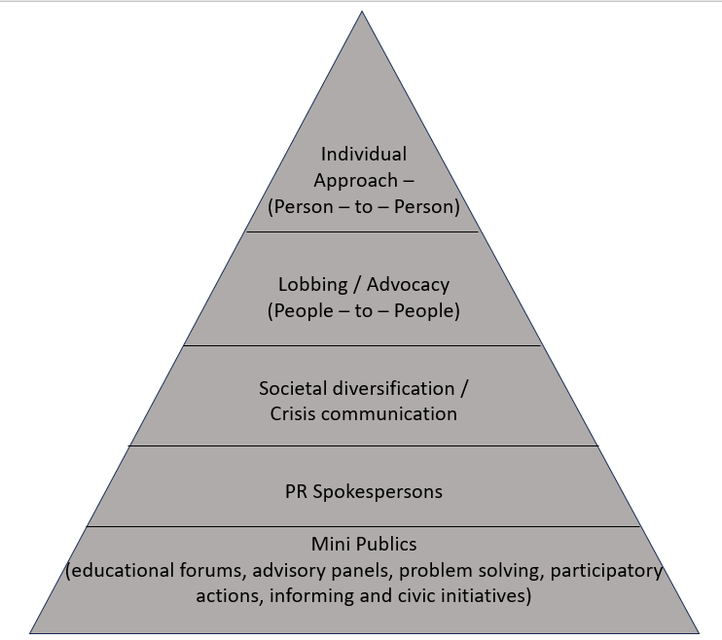
Committed to the role

Slide 11
Recommendations
Establishing a mutual identity of values
Highlighting Strategic Communications - finding an appropriate way in accordance with the social culture to communicate with the public and share the main idea and message
the way to guarantee security prosperity and democratic values.

Slide 12
Increasing expression of "private" and "public" – interaction
Public – Lack of Resources?
We need flexibility for resilience

Slide 13
NATO should
Adopt a more strategic view of partnerships, considering how they can contribute to long-term security by developing institutions and capacities in partner countries;
Establish clear guidelines on how partnerships function during crises, by defining the roles, responsibilities, and obligations;
Include energy independence as part of NATO's defense planning process for providing European countries with a goal to reduce their dependence on Russia for energy supplies. Diversifying energy sources and promoting energy security can contribute to the overall security and resilience of NATO member states.

Slide 14
Implementing such measures would obviously require discussions, consensus-building, and alignment among member states and partner countries.

Slide 15
EU Should:
According to – Act in Support of Ammunition Production (ASAP) – EU can make further investments and build upon existing initiatives like the European Defence Industry Reinforcement through Common Procurement Act (EDIRPA) to create a common defence industrial base across Europe.
Strengthening NATO through a strong European defence industrial base with the capacity to provide European needs - will enable Transatlantic burden-sharing, and support EU member states' armed forces.
Could lead on developing a European pillar in NATO.
*Interview, 08/06/2023, Anna Wieslander | Atlantic Council I Director for Northern Europe

Slide 16
Reconsidering partnerships & strengthening cooperation between NATO and the EU - important aspects of enhancing European security / addressing common challenges.
Reaffirmation of roles (for NATO)
Independence (for the EU).

