Slide 1
Police Academy „THE FIRST CROATIAN POLICE OFFICER” Zagreb, Republic of Croatia
Associate Professor Krunoslav Antoliš, Chief Police Adviser

Slide 2
G E N E R A L P O L I C E D I R E C T O R A T E
OFFICE OF THE GENERAL POLICE DIRECTOR
PUBLIC ORDER AND SECURITY DIRECTORATE
DIRECTORATE FOR SPECIAL SECURITY MEASURES
CRIMINAL POLICE DIRECTORATE
INTERVENTION COMMAND
BORDER POLICE DIRECTORATE
POLICE ADMINISTRATIONS (20)
POLICE ACADEMY
„THE FIRST CROATIAN POLICE OFFICER”
Notes:
Legal framework
Police education is conducted in line with the needs of Police Directorate, general regulations related to area of education and provisions adopted and based on Law on the Police.

Slide 3
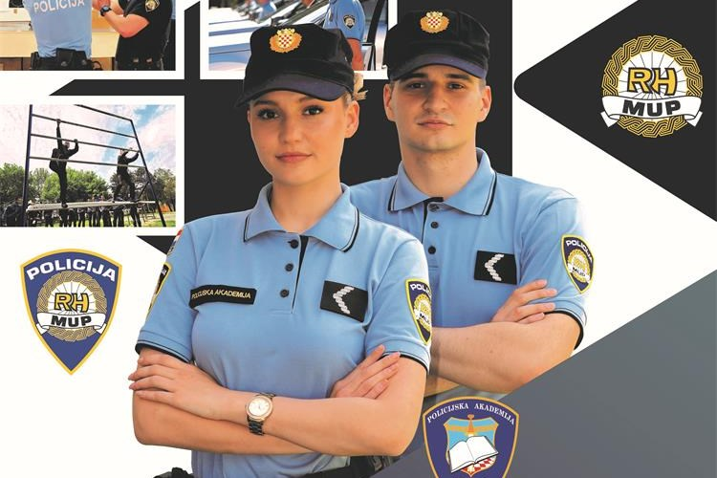
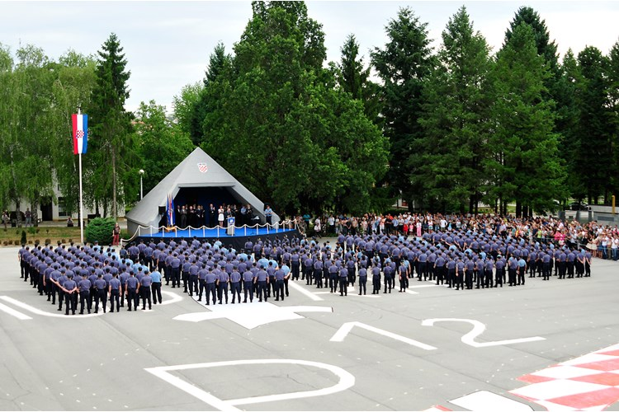
Organisational structure of the Police Academy „THE FIRST CROATIAN POLICE OFFICER”
POLICE ACADEMY „THE FIRST CROATIAN POLICE OFFICER”
Head
and Deputy Head
UNIVERSITY OF APPLIED SCIENCES IN CRIMINAL INVESTIAGITON AND PUBLIC SECURITY
Dean/Head
JOSIP JOVIĆ POLICE SCHOOL
Head
DEPARTMENT FOR LIFELONG LEARNING
Head
DEPARTMENT FOR THE DEVELOPMENT OF POLICE EDUCATION AND INTERNATIONAL COOPERATION
Head
TRAINING CENTER FOR DOG HANDLERS AND SERVICE DOGS
Head
DEPARTMENT FOR LIBRARY. PUBLISHING AND POLICE MUSEUM
Head
DEPARTMENT FOR COORDINATION AND IMPLEMENTATION OF PROJECTS AND RESEARCH
Head
DEPARTMENT FOR POLICE TRAINING
Head

Slide 4
University of Applied Sciences in Criminal Investigation and Public Security TWO study programs
undergraduate studies (3 years, 180 ECTS, bachelor’s degree) – about 200 full-time and more than 300 part-time students
graduate studies (2 years, 120 ECTS, master’s degree) – about 300 part-time students

Slide 5
Lifelong learning
PROFESSIONAL DEVELOPMENT:
Continuous training – knowledge and skills (competences)
SPECIALIZATION:
Specialized Courses and Seminars - license for a special police line of work
Final exam in front of the commission
VOCATIONAL TRAINING:
Police career training, special duties, external users

Slide 6
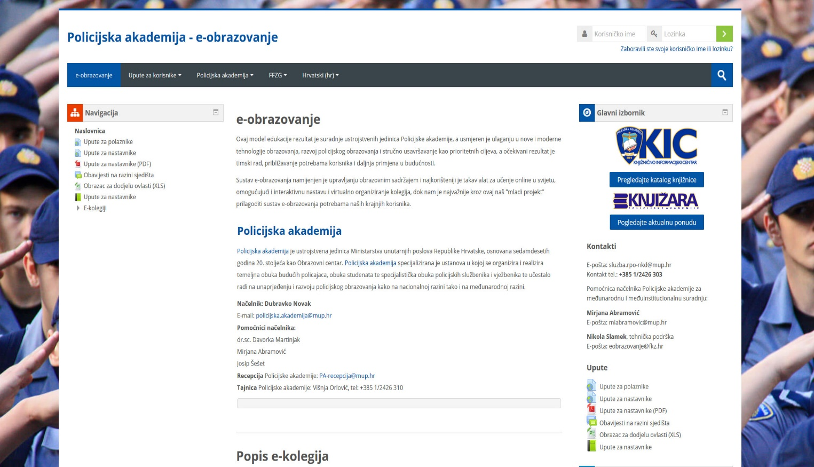
E-learning – PRIORITY Impact of modern technology in education
E-education at the Police Academy „The First Croatian Police Officer” https://e-obrazovanje.fkz.hr/
New and modern form of education conducted and organized by the Academy

Slide 7
INTERNATIONAL ASPECTS OF POLICE EDUCATION
FRONTEX – European Border and Coast guard agency
Cooperation with federal Police academy in Germany Common effort on capacity building: border surveillance with respect to human rights
CEPOL – European Union Agency for Law Enforcement Training
Cooperation with Police academy in Turkey through Memorandum of cooperation
Partnership for Education - regional training in cooperation with USA embassy in Zagreb
EU PROJECTS – ERASMUS & ERASMUS+

Slide 8
ICT & disinformation
Associate Professor Krunoslav Antoliš, Chief Police Adviser,
University of Criminology and Public Security,
Police academy "First Croatian Police Officer"
Ministry of Internal Affairs
Republic of Croatia
Program: Erasmus+
Action Type: KA220-HED - Cooperation partnerships in higher education
Participating Organizations: SISEKAITSEAKADEEMIA, Estonia, TALLINN; MYKOLO ROMERIO UNIVERSITETAS Lithuania, Vilniaus apskritis, VILNIUS; University of Criminology and Public Security, Police academy "First Croatian Police Officer", MINISTRY OF INTERIOR, Croatia, Grad Zagreb.
Notes:
izv.prof.dr.sc. Krunoslav Antoliš, glavni policijski savjetnik, Veleučilište kriminalistike i javne sigurnosti, Policijska akademija "Prvi hrvatski redarstvenik", MUP RH/ Associate Professor Antoliš Krunoslav, PhD, Chief Police Adviser, University of Criminology and Public Security, Police academy "First Croatian Police Officer", Ministry of Internal Affairs, Republic of Croatia
In today's world, information and communication technologies (ICT) have changed the way we live, work and communicate. With the rise of social media and the ease of sharing content online, disinformation campaigns have become easier to spread than ever before. This has led to a growing problem that threatens the integrity of information on the Internet, to the problem of disinformation. We understand disinformation as the deliberate dissemination of false information with the intention of deceiving, manipulating or harming individuals, groups or societies.The misuse of disinformation, especially through information and communication technologies (ICT), has a wide range of negative effects, including: misleading the public, undermining democracy, creating divisions, diverting attention from real problems, harming individuals and organizations, hindering scientific progress, and in extreme cases recruiting terrorist.

Slide 9
Hybrid threats in the ICT environment
Hacktivism,
Terrorism in Cyberspace,
Espionage in Cyberspace
Warfare in Cyberspace
Economic destabilization
Disinformation Campaigns

Slide 10
Economic destabilization
This process can involve various activities, including the following:
Manipulation of the currency market
Trade sanctions
Intentional spread of financial crisis
Sabotage of industrial production
Manipulation of energy prices
Notes:
Economic destabilization is the process of deliberately disrupting the economic system of a country or region in order to achieve a certain political or military goal.
Manipulation of the currency market: Through interventions in the foreign currency market, a country or organization can influence the value of another country's currency and thus reduce its purchasing power.
Trade sanctions: The imposition of trade sanctions can negatively affect the economic growth of another country, reduce exports and increase its dependence on imports.
Intentional spread of financial crisis: Injecting a large amount of money into a sector may temporarily stabilize the situation, but at the same time increases the risk of a long-term economic crisis and inflation.
Sabotage of industrial production: Damage or destruction of production capacity can lead to shortages of goods and services and disruptions in the supply chain, which can lead to destabilization of the economy.
Manipulation of energy prices: Manipulation of oil, gas or other energy prices can affect the economy of another country and lead to a decrease in its competitiveness in the market.
The above examples are only some of the ways in which economic destabilization can be carried out. In any case, this process is usually complex and time-consuming, and can lead to long-term negative consequences for the economy and population of the country or region that was targeted.

Slide 11
Disinformation campaigns in cyberspace
… refer to the deliberate spreading of false or misleading information with the aim of manipulating public opinion or influencing decision-making processes.
This can involve the use of fake news stories, propaganda, or social media bots.

Slide 12
Misinformation & Disinformation
Misinformation and disinformation are both types of false or misleading information.
Misinformation refers to information that is false or inaccurate, but may not necessarily be deliberately spread or intended to deceive.
Disinformation refers to deliberately false or misleading information that is spread with the intention of deceiving or manipulating people.
Disinformation can be used for a variety of purposes, such as political propaganda, misinformation campaigns, or to promote a specific agenda or ideology.
The key difference between misinformation and disinformation is that misinformation may be unintentional or the result of innocent mistakes, while disinformation is deliberately created and spread with the intention of deceiving or manipulating people.
Notes:
Misinformation and disinformation are both types of false or misleading information, but there is an important distinction between the two.
Misinformation refers to information that is false or inaccurate, but may not necessarily be deliberately spread or intended to deceive. Misinformation can be the result of mistakes or errors, misunderstandings, or the spread of rumors and hearsay.
Disinformation, on the other hand, refers to deliberately false or misleading information that is spread with the intention of deceiving or manipulating people. Disinformation can be used for a variety of purposes, such as political propaganda, misinformation campaigns, or to promote a specific agenda or ideology.
The key difference between misinformation and disinformation is that misinformation may be unintentional or the result of innocent mistakes, while disinformation is deliberately created and spread with the intention of deceiving or manipulating people.

Slide 13
Misuse of disinformation
Misleading the Public
Undermining Democracy
Creating Division
Distracting from Real Issues
Harming Individuals and Organizations
Impeding Scientific Progress
Notes:
Misuse of disinformation can have a wide range of negative impacts, including:
Misleading the Public: Disinformation can be used to mislead and manipulate public opinion. When people are exposed to false or misleading information, they may make decisions based on incorrect assumptions or beliefs. This can have serious consequences for individuals, organizations, and entire societies.
Undermining Democracy: Disinformation can be used to undermine the integrity of democratic processes. When false or misleading information is spread about political candidates, issues, or outcomes, it can undermine the public's confidence in the electoral process and lead to a lack of trust in government institutions.
Creating Division: Disinformation can be used to create divisions between groups of people, fueling prejudice and hate. This can lead to social unrest, conflict, and even violence.
Distracting from Real Issues: Disinformation can be used to distract people from real issues that require attention and action. By creating sensational or controversial stories, disinformation can divert attention away from important topics and prevent meaningful dialogue and progress.
Harming Individuals and Organizations: Disinformation can harm individuals and organizations by damaging their reputation or causing financial harm. For example, false information spread about a product or service can lead to financial losses for a company, or false accusations against an individual can damage their personal and professional reputation.
Impeding Scientific Progress: Disinformation can impede scientific progress by spreading false or misleading information about scientific research or data. This can lead to a lack of trust in scientific institutions and delay progress in important areas of research.

Slide 14
Psychological drivers
There are several psychological drivers that can lead individuals to believe and perpetuate misinformation, as well as resist correction even when presented with accurate information.
Confirmation bias
Cognitive dissonance
Overconfidence and the illusion of knowledge
Social influence
Emotional reasoning
Notes:
There are several psychological drivers that can lead individuals to believe and perpetuate misinformation, as well as resist correction even when presented with accurate information.
These include:
Confirmation bias
Cognitive dissonance
Overconfidence and the illusion of knowledge
Social influence
Emotional reasoning

Slide 15
Resist correction
When people encounter accurate information that contradicts their beliefs, they may resist correction because it threatens their sense of identity and can be psychologically uncomfortable. This can lead to motivated reasoning, where people selectively evaluate and interpret information in a way that supports their existing beliefs and ignores evidence to the contrary.
Overcoming misinformation belief and resistance to correction requires addressing these psychological drivers, which can be challenging.
Effective strategies may include using messaging that appeals to emotions and values, highlighting the consensus of scientific experts, providing clear and compelling evidence, and presenting corrections in a non-threatening and non-judgmental manner.
It is also important to promote critical thinking skills and media literacy education to help people evaluate information more objectively and resist misinformation.

Slide 16
Develop critical thinking skills
Teach critical thinking skills:
Begin by defining critical thinking and explaining why it is important.
Provide examples of situations where critical thinking is necessary and show how it can be applied in everyday life.
Teach how to ask questions
Encourage independent thinking
Teach how to evaluate evidence
Teach how to recognize logical fallacies
Provide opportunities to practice
Encourage discussion and debate
Notes:
Developing critical thinking skills and media literacy education are important strategies for helping people evaluate information more objectively and resist misinformation. Here are some key ways in which these skills can be developed:
Teach critical thinking skills: Critical thinking involves analyzing information, evaluating evidence, and making reasoned judgments based on evidence. Teaching critical thinking skills can help people evaluate information more objectively and resist misinformation. This can include teaching people to identify bias, evaluate the credibility of sources, and recognize logical fallacies.
Critical thinking skills are essential for making informed decisions, solving problems, and evaluating information in a rational and objective manner. Here are some steps that can be taken to teach critical thinking skills:
Start with the basics: Begin by defining critical thinking and explaining why it is important. Provide examples of situations where critical thinking is necessary and show how it can be applied in everyday life.
Teach how to ask questions: Critical thinking involves asking questions and seeking answers. Teach people how to ask open-ended questions that encourage exploration and investigation. Encourage them to think beyond surface-level information and dig deeper to uncover the underlying causes and motivations.
Encourage independent thinking: Encourage people to think for themselves and avoid simply accepting information without questioning it. Teach them to be skeptical of information that seems too good to be true or that lacks credible sources.
Teach how to evaluate evidence: Teach people how to evaluate evidence and assess the credibility of sources. Encourage them to look for reliable sources of information and to consider the qualifications and biases of the authors.
Teach how to recognize logical fallacies: Logical fallacies are common errors in reasoning that can lead to false conclusions. Teach people how to recognize common fallacies such as ad hominem attacks, strawman arguments, and false dichotomies.
Provide opportunities to practice: Provide people with opportunities to practice critical thinking skills. This could involve analyzing news articles, evaluating scientific studies, or solving complex problems.
Encourage discussion and debate: Encourage people to engage in respectful discussion and debate. This can help them to see different perspectives and to learn from others.
By teaching critical thinking skills, we can help people to evaluate information more objectively, resist misinformation, and make better decisions. These skills are essential for success in both personal and professional life.

Slide 17
Promote media literacy education
To develop ability to identify sources of information.
To evaluate the quality of evidence and recognize common biases that may influence information.
To recognize the influence of media on their attitudes and beliefs.
Individuals can identify the messages being conveyed and develop their own opinions based on objective evaluation.
To teach individuals how to evaluate information critically,
By promoting media literacy, we can equip individuals with the skills necessary to navigate the digital world with confidence and discernment.
Notes:
Media literacy education can help people become more discerning consumers of media and better able to evaluate the accuracy and credibility of information. This can include teaching people to identify the sources of information, evaluate the quality of evidence, and recognize the influence of media on our attitudes and beliefs.
Media literacy is an essential skill for individuals living in the digital age. With an abundance of information readily available, it can be challenging to distinguish between reliable and unreliable sources. Media literacy education empowers individuals to be critical consumers of information, enabling them to make informed decisions based on accurate and trustworthy information.
One of the most important aspects of media literacy is the ability to identify sources of information. By understanding the various types of sources, such as primary, secondary, and tertiary sources, individuals can determine the credibility and accuracy of information presented. Additionally, media literacy education can help individuals evaluate the quality of evidence and recognize common biases that may influence information.
Furthermore, media literacy education can help individuals recognize the influence of media on their attitudes and beliefs. By understanding how media is constructed, individuals can identify the messages being conveyed and develop their own opinions based on objective evaluation.
Promoting media literacy education can have significant benefits for individuals, communities, and society as a whole. By teaching individuals how to evaluate information critically, we can combat misinformation and disinformation, promote civic engagement, and foster a more informed and educated public.
In conclusion, media literacy education is crucial in today's society, where the consumption of information is abundant. By promoting media literacy, we can equip individuals with the skills necessary to navigate the digital world with confidence and discernment.

Slide 18
Encourage skepticism
Skepticism can help people avoid being misled by false or misleading information and make better-informed decisions.
To encourage skepticism, it's important to teach people to critically evaluate information they encounter.
This can involve asking questions such as: What evidence supports this claim? Who is making this claim, and what are their motivations? Are there alternative explanations for this information? Is this information consistent with what I already know or believe?
Encouraging skepticism can also help people be open to changing their beliefs when presented with new evidence, rather than holding onto outdated or incorrect ideas.
It's also important to recognize that skepticism is not the same as cynicism or distrust. Skepticism involves a healthy dose of questioning and critical thinking, while cynicism and distrust can lead to a lack of engagement and apathy.
Notes:
Encouraging skepticism is important in today's world, where there is an abundance of information available at our fingertips. Skepticism can help people avoid being misled by false or misleading information and make better-informed decisions. To encourage skepticism, it's important to teach people to critically evaluate information they encounter. This can involve asking questions such as: What evidence supports this claim? Who is making this claim, and what are their motivations? Are there alternative explanations for this information? Is this information consistent with what I already know or believe?
By teaching people to ask these types of questions, they can become more discerning consumers of information and develop the skills necessary to make informed decisions. Encouraging skepticism can also help people be open to changing their beliefs when presented with new evidence, rather than holding onto outdated or incorrect ideas.
It's also important to recognize that skepticism is not the same as cynicism or distrust. Skepticism involves a healthy dose of questioning and critical thinking, while cynicism and distrust can lead to a lack of engagement and apathy. Encouraging skepticism can help people engage more fully with the world around them and make more informed decisions.

Slide 19
Provide diverse perspectives
From a sociological perspective
From a psychological perspective
From an economic perspective
From a political perspective
From a moral perspective
Notes:
Provide diverse perspectives: Exposure to diverse perspectives can help people understand different viewpoints and become more tolerant of different opinions. This can help to reduce the influence of confirmation bias and encourage critical thinking.
Exposure to diverse perspectives can broaden one's understanding of the world and help develop empathy for people from different backgrounds. Here are some diverse perspectives on the importance of exposure to diverse perspectives:
From a sociological perspective: Sociologists argue that exposure to diverse perspectives is essential for promoting social cohesion and reducing conflicts in society. By understanding different cultural values and beliefs, individuals can develop respect and tolerance for each other, which can lead to a more harmonious society.
From a psychological perspective: Psychologists suggest that exposure to diverse perspectives can help individuals overcome their confirmation bias and develop critical thinking skills. By being exposed to different viewpoints, people are forced to consider alternative ideas and question their assumptions, which can lead to a more nuanced understanding of complex issues.
From an economic perspective: Economists argue that exposure to diverse perspectives can improve innovation and productivity in the workplace. By bringing together individuals with different skills, experiences, and backgrounds, teams can develop more creative and effective solutions to problems.
From a political perspective: Political scientists suggest that exposure to diverse perspectives is essential for democracy to function effectively. By understanding different political ideologies and perspectives, individuals can make informed decisions about who to vote for and what policies to support.
From a moral perspective: From a moral perspective, exposure to diverse perspectives is important because it helps individuals develop compassion and empathy for people who are different from themselves. By understanding the challenges faced by people from different backgrounds, individuals can work towards creating a more just and equitable society.
Overall, exposure to diverse perspectives is important because it promotes understanding, tolerance, and critical thinking, which are essential for building a better world.
Overall, developing critical thinking skills and media literacy education can help people evaluate information more objectively and resist misinformation. These skills are important for promoting informed decision-making and protecting against the influence of false or misleading information.

Slide 20
How artificial intelligence affects different aspects related to disinformation
Generation of Disinformation
Disinformation Detection
Social Network Analysis
Information Verification
Content Personalization
Automating Fact-Checking
Media Manipulation Detection
Deepfake Detection
Real-Time Monitoring
Sentiment Analysis
Response Generation
Collaborative Filtering
Notes:
Generation of Disinformation:
AI models, especially generative ones like GPT-3, can be misused to create convincing false information. The ability to generate authentic-sounding text makes it easier to produce deceptive content.
Disinformation Detection:
AI is used to develop algorithms that can automatically detect potential instances of disinformation. These algorithms analyze text, images, and videos to identify patterns indicative of false or misleading content.
Social Network Analysis:
AI can analyze social media activities to identify coordinated campaigns, fake accounts (bots), and amplification networks that spread disinformation. It helps uncover patterns of behavior that might not be easily noticeable manually.
Information Verification:
AI tools can assist in verifying the authenticity of information by cross-referencing multiple sources and fact-checking databases. This can aid in quickly identifying false claims and rumors.
Content Personalization:
AI algorithms are used to personalize content for users based on their preferences and browsing history. This personalization can be exploited to tailor disinformation to specific individuals, making it more convincing.
Automating Fact-Checking:
AI-powered fact-checking tools can quickly assess claims and verify information by comparing them against trusted sources. While not perfect, these tools can help automate the fact-checking process.
Media Manipulation Detection:
AI can identify manipulated images, audio, and video content. Deep learning models can spot inconsistencies and artifacts that might indicate media manipulation.
Deepfake Detection:
Deep learning techniques are used to develop tools that can identify deepfakes – highly convincing manipulated videos that can spread false information.
Real-Time Monitoring:
AI algorithms continuously monitor online platforms for trends and emerging narratives, helping to identify potential disinformation campaigns early on.
Sentiment Analysis:
AI can gauge the sentiment of online discussions and identify content that is designed to evoke emotional responses or exploit biases, which are common tactics in disinformation.
Response Generation:
AI-powered chatbots or response generators can spread disinformation by engaging in online discussions and echoing false narratives.
Collaborative Filtering:
AI-based recommendation systems can inadvertently reinforce echo chambers by showing users content aligned with their existing beliefs, which can contribute to the spread of disinformation.
The impact of AI on disinformation is complex, as these technologies can be both a part of the problem and part of the solution. Responsible and ethical development, deployment, and usage of AI tools are essential to mitigate their negative effects and leverage their potential to counter disinformation effectively.

Slide 21
The research was conducted (during March and April 2023.) at the University of Applied Sciences in Criminal Investigation and Public Security in Zagreb
278 participants (63.3% M, 36.7% F) with an average age of 29.29 years
All participants were students
69.9% - Professional study of criminology (undergraduate study),
30.1% - Specialist graduate study, of which 74.8% are employees of the MoI.
Of all police officers in the sample, with an average length of service of 6.23 years (Sd= 5.37), 23.4% of them work in basic police work, 18% in criminal work, 15.1% in border work, 8, 6% in traffic and 5.1% in the intervention police unit.

Slide 22
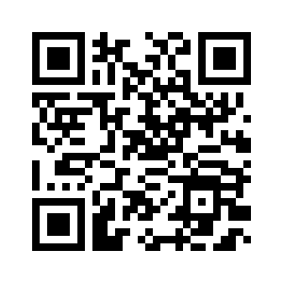
Research - instruments
Three groups of questionnaires were used in the research:
Questionnaire of sociodemographic data 11 questions,
Questionnaire of attitudes and beliefs about disinformation 42 items divided into 4 subscales:
the impact of disinformation,
the purpose of creating and disseminating disinformation,
the recognition of disinformation and
the frequency of disinformation in the media,
Questionnaire of behavior on the Internet 38 items that were divided into 4 subscales:
security protection,
protection from disinformation,
negative experiences on the Internet, u
se of social networks and Internet portals..

Slide 23
Research - results
The results show that the majority of respondents (66.9%) believe that they are sufficiently informed about the dangers of disinformation, and that they easily distinguish misinformation from the truth (55.4%), while less than half of them (48.9%) believe that they are also sufficiently informed about the ways to distinguish disinformation. Furthermore, men use methods to verify the truth of information significantly more often than women (t=2.674, df=276, p=0.008).
The regression model resulted in the two most significant predictors: individuals who are more likely to use methods to protect their privacy and security on the Internet (β =0.7, p < .05) and individuals who believe that they are better informed about the dangers and ways to recognize disinformation (β =0.106 , p < .05), so they more often use methods to check the veracity of information (R2=0.551, F=168.821, p<0.001).
Correlation analysis suggests that those individuals who believe that disinformation has a more significant impact on society and that disinformation is more frequent in the media also use methods to verify the veracity of information more often.

Slide 24
Conclusion
Countering disinformation requires comprehensive and collaborative strategies that include education, media literacy, regulation, cooperation between sectors and the application of technological tools to verify and analyze information.
It is important to note that although artificial intelligence has a significant role to play in the fight against disinformation.
This research provides a valuable insight into the perception and behavior of the participants regarding disinformation on the Internet and points to the importance of education and information in order to fight against the spread of disinformation.
In today's digital age, the ability to recognize false information is important for making informed decisions. In professional policing, this becomes crucial to ensure safety and public confidence. Critical thinking, using fact-checking tools and being educated about various disinformation techniques will help maintain the integrity and effectiveness of police work.
Balancing the regulation of ICT and addressing disinformation with the principles of free speech, privacy, and open communication is a complex endeavor. Effective regulation and response strategies need to be carefully crafted to address the challenges posed by the rapid evolution of technology and the dissemination of information.
Striking the right balance between regulating ICT, safeguarding privacy, and addressing disinformation is essential for creating a safe, inclusive, and informed digital environment.
Notes:
Countering disinformation requires comprehensive and collaborative strategies that include education, regulation, cooperation between sectors, and the application of technological tools to verify and analyze information.
This research provides a valuable insight into the perception and behavior of the participants regarding disinformation on the Internet and points to the importance of education and information in order to fight against the spread of disinformation.
In today's digital age, the ability to recognize false information is important for making informed decisions. In professional policing, this becomes crucial to ensure safety and public confidence. Critical thinking, using fact-checking tools and being educated about various disinformation techniques will help maintain the integrity and effectiveness of police work.
The digital landscape is constantly evolving, and addressing these challenges requires a multi-pronged approach involving governments, tech companies, civil society, and individuals. Balancing the regulation of ICT and addressing disinformation with the principles of free speech, privacy, and open communication is a complex endeavor. Effective regulation and response strategies need to be carefully crafted to address the challenges posed by the rapid evolution of technology and the dissemination of information. Striking the right balance between regulating ICT, safeguarding privacy, and addressing disinformation is essential for creating a safe, inclusive, and informed digital environment.

Slide 25
Questions & Answers Comments !!!
Associate Professor Krunoslav Antoliš, Chief Police Adviser

